Slide 1
Separation of Healthy Rice Seeds Using Density Flotation Method
A Simple Technique for Seed Quality Improvement
Presenter Name: Bikas Basnet
Institution | BSS
Date: 2082-02-26

Slide 2
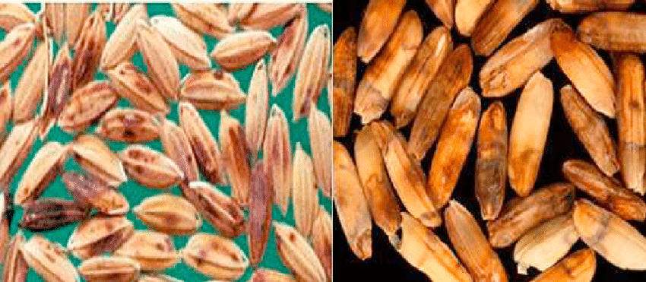
Introduction
- Importance of seed quality in rice cultivation
- Common problems: poor germination, diseased or immature seeds
- Need for efficient, low-cost seed separation methods

Slide 3
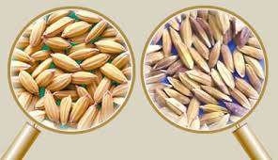
Objective
- To separate healthy, viable rice seeds from damaged or low-quality seeds using the density flotation method

Slide 4
Principle of Density Flotation
- Seeds differ in density depending on:
• Maturity
• Moisture content
• Structural integrity
- Healthy seeds: higher density → sink
- Unhealthy/damaged seeds: lower density → float

Slide 5
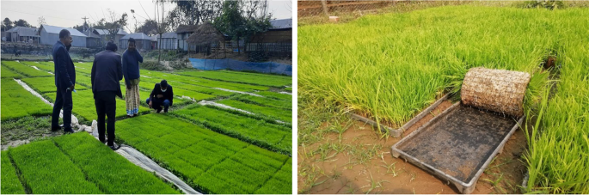

Slide 6
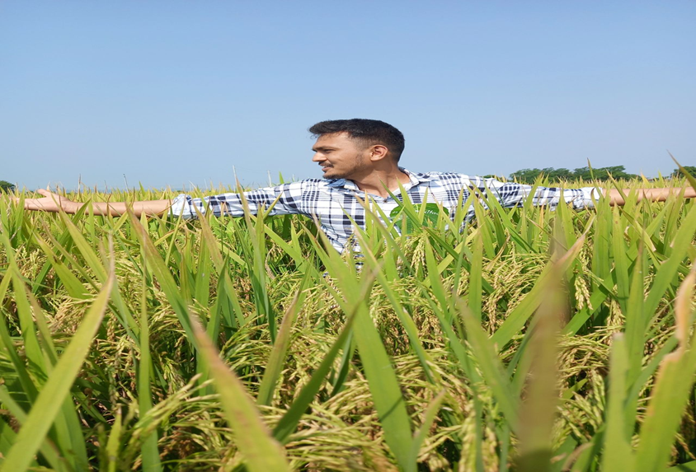

Slide 7
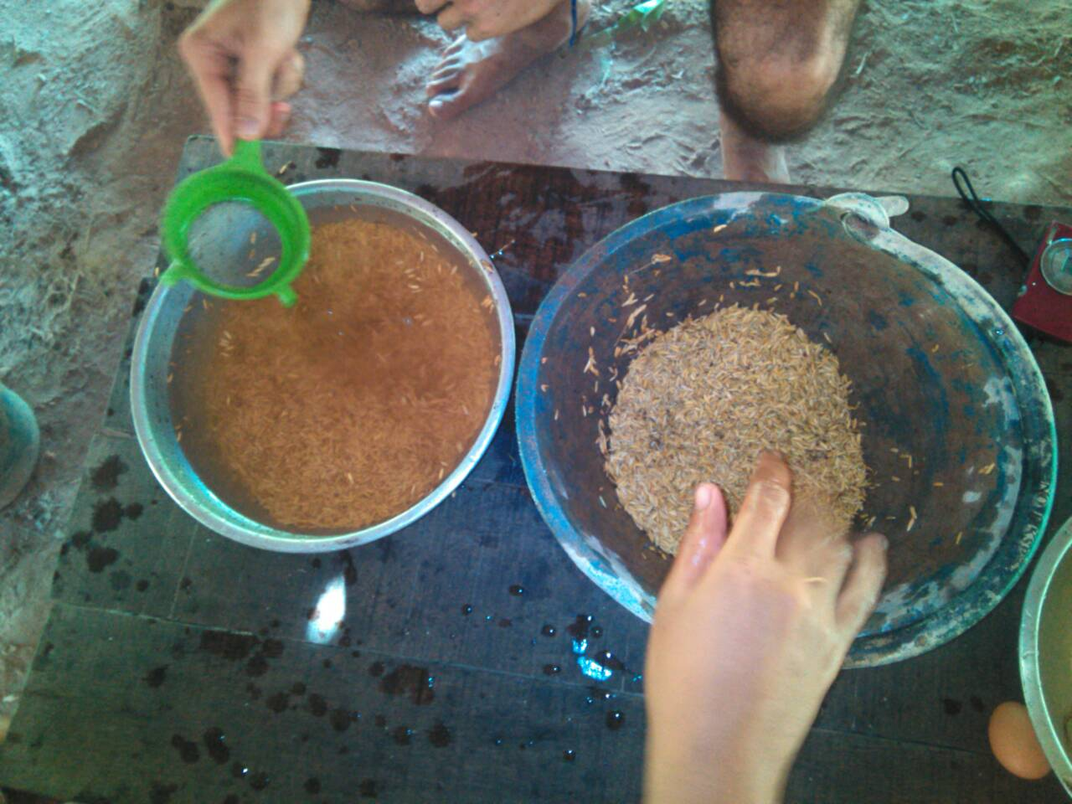
Materials Required
- Rice seeds (sample)
- Water
- Salt (NaCl) or sugar (optional, to adjust density)
- Beaker or container
- Stirring rod
- Sieve or strainer
- Towel or drying tray

Slide 8
Procedure
1. Fill container with clean water
2. Add salt/sugar to adjust density (optional)
3. Stir and let the solution settle
4. Add rice seeds
5. Allow to stand for 2–3 minutes
6. Separate:
- Floating seeds = discard
- Sinking seeds = collect and dry

Slide 9
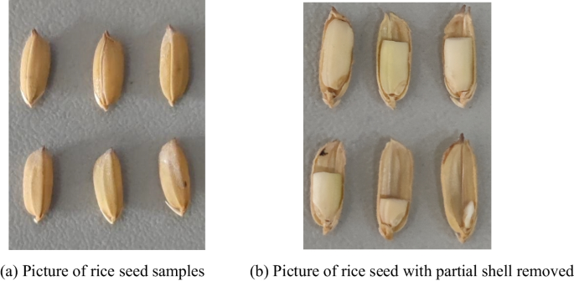
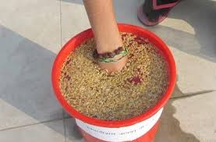
Observations
- Clear separation into two layers
- Floating seeds: lightweight, likely non-viable
- Sinking seeds: healthy, suitable for sowing
- Salt concentration affects sensitivity

Slide 10
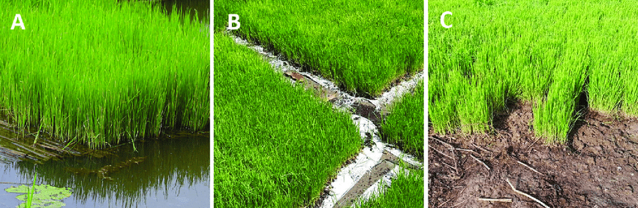
Results
- X% of seeds were discarded as floaters
- Y% retained as viable, healthy seeds
- Improved germination rate confirmed in follow-up testing (optional)

Slide 11
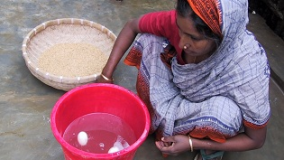

Advantages
- Simple and inexpensive
- No need for complex equipment
- Quick and efficient
- Can be scaled for small farms

Slide 12
Limitations
- May not detect internal fungal/bacterial infections
- Requires drying after separation
- Salt residues must be washed off before sowing (if used)

Slide 13
Conclusion
- Density flotation is an effective method for preliminary seed quality screening
- Ensures better germination and healthier crops
- Recommended as a standard pre-sowing practice

